Slide 1
Brain Modeling : A very simple Network model of the Human Brain
By
Joel Sande
Summer 2016

Slide 2
Presentation Overview
Introduction : Brain, Neuron and Connections
Objectives :
Model and Implementation
First Results
A couple of comparisons
Conclusion
Limitations
Futur work

Slide 3
1- Introduction : Brain, Neuron and Connections
The nervous system is a set of a billion of neurons that communicate with each-other through a billion of billions of synaptic connections. It is apparent to a set of electrical cables connecting nodes, forming a huge network. Most published studies on diseases of the nervous system face the problem of complexity of the nervous system as its whole.
It is difficult to tell accurately the reason of a dysfunction; this is the case of Autism: Although symptoms of the disease are known, there is no consensus on the reasons of such a phenomenon. Some authors talk about spend energy related to long-distance connections, others talk of poor synchronization between the left hemisphere and the right hemisphere, others talk about poor quality of the gray matter, namely, the myelination of axons, key for inter-regional communication, … Those are known through Infra-red and a bunch of scanning tools.
It is very hard for Biologists to figure out what is really going on. We then need model with which we can manipulate different possibilities and observe the results.

Slide 4
2- Objectives
Multi data processing with network implementation in order to mimick the Humain Brain, and try to identify potential reason for dysfunctions like Autism, Alzheimer, Parkingson, …
Build 2 X 3D networks with as much as neuron possible (Abnormal Network → Dysfunction Vs Normal Network → Safe).
Analysing :
Simple Correlations between parameters such as ATP and length all along the signal processing.
How does a specific parameters change between those 2 Networks can make a difference
… (if time allows)

Slide 5
3-Model and Implementation
A) Model
I choose not to use in a first step the huge and enormous equations that rules neurons input and signal transfer we may see in the literature, in Electrical and physics. Instead, I used the simplified model of neuro-psychology, which is easier to implement. However, those equations in Electrical can be included in the model.
Action Potential that decide whether a Neurone fires or not is not based on Boolean value but based on both time and neurotransmitter abundance.
∑ ( neurotrans X action ) = received inpulse
if received impulse >= Threshold then –> Fire
I consider the time in the entire Network, and this time is based on the time recorded at signal input (button press).

Slide 6
3-Model and Implementation
A) Model
I started with 64 neurons in the Network (just to avoid long time running more than 1000 Neurons which is the final goal for now).
I have 1 Main_File that store the information on all Neurons (ID, myelinated or not, strength of myelin, if it is an Activator, if it is an Inhibitor, coordinates X, Y, Z in 3D space, Action_Potential_Threshold).
I designed a graphical interface that allows to directely Update that File (In a random way, and also in specific way : Ex: one can choose how one want the Neuron_X to behave with its neighboor).
I have 64 Files That store each Neuron interaction (1 File per Neuron).
With the graphical interface, one can directly update the behavior of any Neuron with its Neighboors. Then, there is 2 ways to update :
Either by area (you update interactions of neurons located in the selected area : the best choice for general analysis).
Either by ID (you update interactions of neurons taping is ID: this would be the best choice for very-very deep analyse, but extremely long to do with 1 million neurons).
Regarding Neuron Interactions: it is information such as : Neighboors (consequentelly I have 64 lines), behave = Activation or Inhibition or Nothing (this depend on the previous Main_file), Strenght of that interaction, duration of signal transmission, length with the Neighboor, ATP spent while the signal is travelling, Current time of signal perception.
In the next slide, all stuff put in color are not random; They depend on the interaction with the neighboors on the Network.

Slide 7
3-Model and Implementation
A) Model
Activation or Inhibition or Nothing (this depend on the previous Main_file) : When a Neuron is an activator, it is a (+1). When it is a inhibitor, it is a (-1). When He receives a signal, He transfers that signal to its neighboors. Then there is 2 cases : He may transfer a negative signal (inhibitory signal) or a positive signal (activator signal).
If He transfers a positive signal, and that neighboor fires, that firing strengthens their relationship ; in case of non-firing, it diminish their relationship
If He transfers a negative signal, and that neighboor fires, that firing diminishes their relationship ; in case of non-firing, it strengthen their relationship.
Strength of that interaction : Dependent on quantity of neurotransmittor.
Duration of signal transmission : depends on both distance between 2 neurons, and the force of the Myelin layer; The longer is the distance, the longer it takes the signal to travel. The thicker is the myelin layer, the faster the signal can travel.
Length with the Neighboor : It s based on the Cartesian distance between 2 neurons. I added 0 - 10% margin because neural connections are almost never straight.
ATP spent while the signal is travelling : Inversely proportional to the thickness of the myelin and the length of the axon.
Current time of signal perception : This allows Matlab to follow the signals. Actually, there are no real signal : those are just timing to follow an imaginary signal through the network.

Slide 8
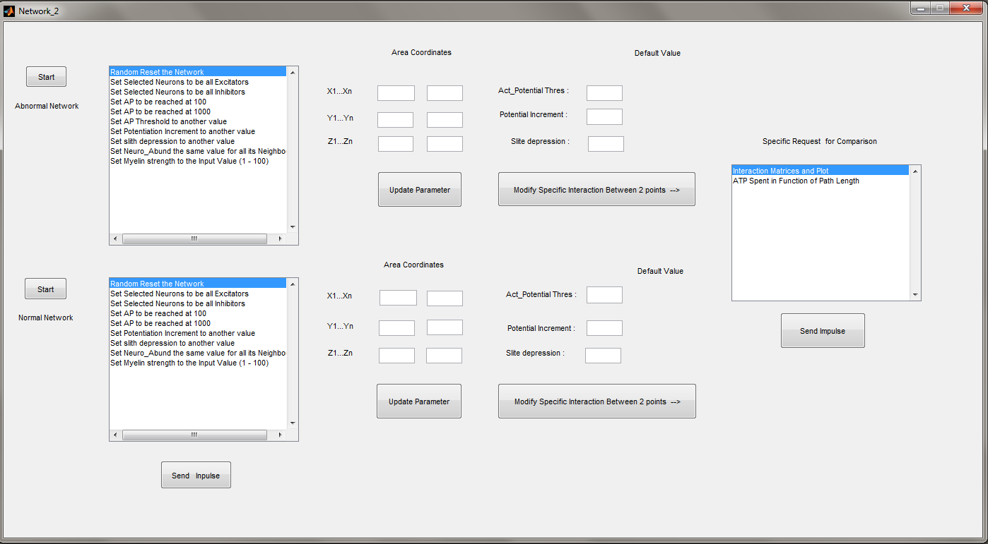
3-Model and Implementation
Edit text allow set-up Action potential Theshold, incrementation Vs decrementation jump
B) Implementation : done with Matlab
Edit text allows to modify specific areas
This button is to modify a specific interaction between 2 points. It opens a other frame. I will go there in a couple of slides.
Starting point for each network after loading the application
Then selected, it allow me to specify which test I want to perform
Once you select an item on the lisbox, you fill the edit text, then press update
There are 2 ways to send an inpulse. So far I am using the one at left, but once the work will be completely done, we will have to use only the one at right

Slide 9
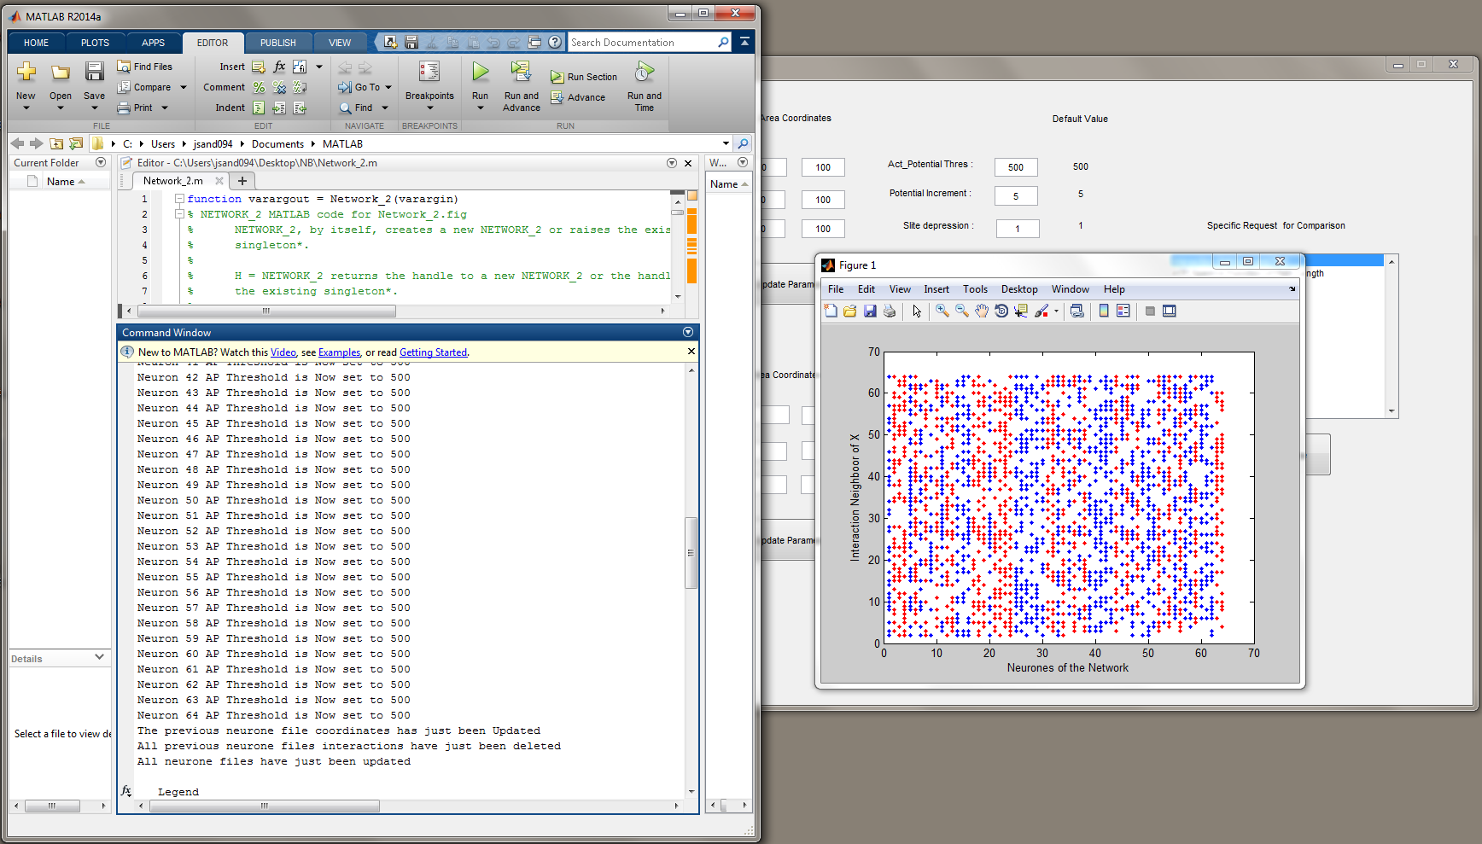
4-First Results
Plot Matrice of connection between the 64 Neurons of the Network
64 Neuron in the current network. The goal is to reach 1000+ Neurons
Blue dot means activation while red dots means inhibition. As you can See, Neurons x(1). The selected are neighboors of Neurons 1(activator) and 2 (inhibitor)

Slide 10
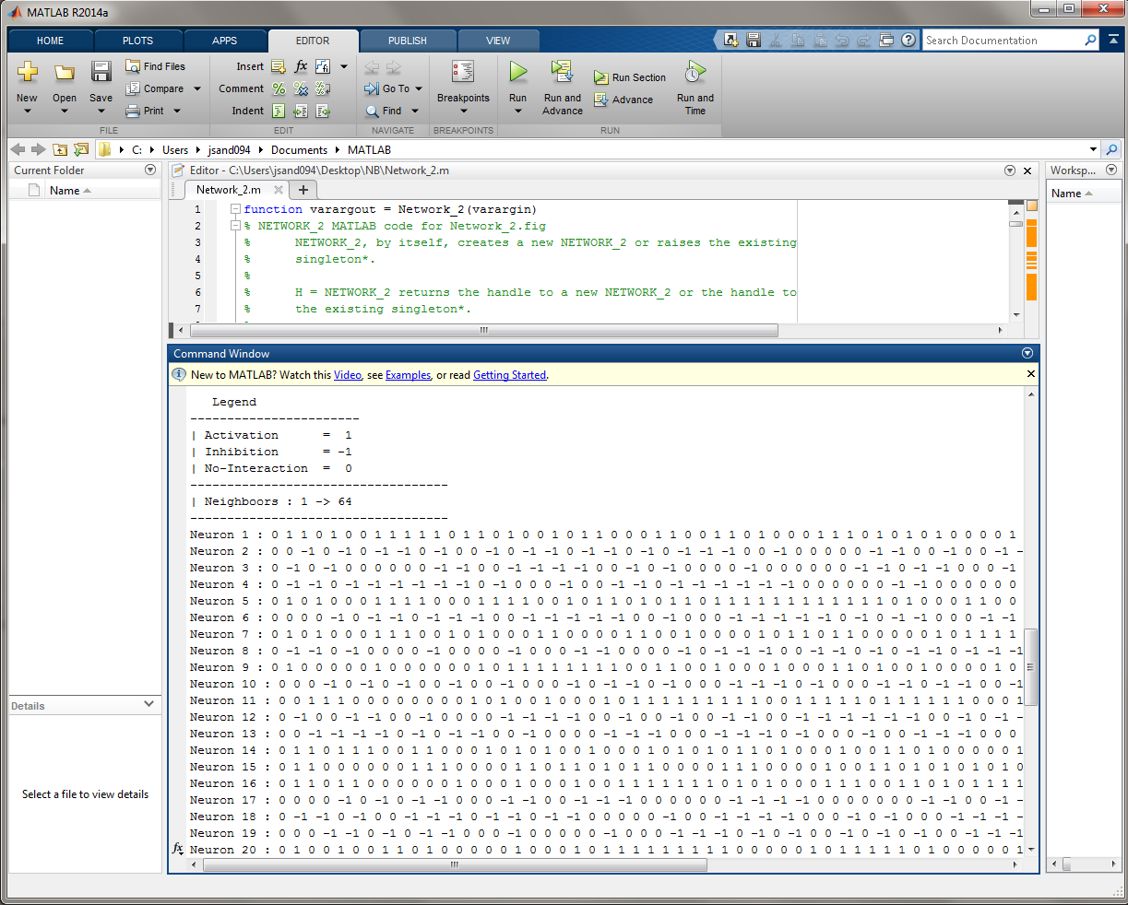
4-First Results
Another view of the Connection Matrice

Slide 11
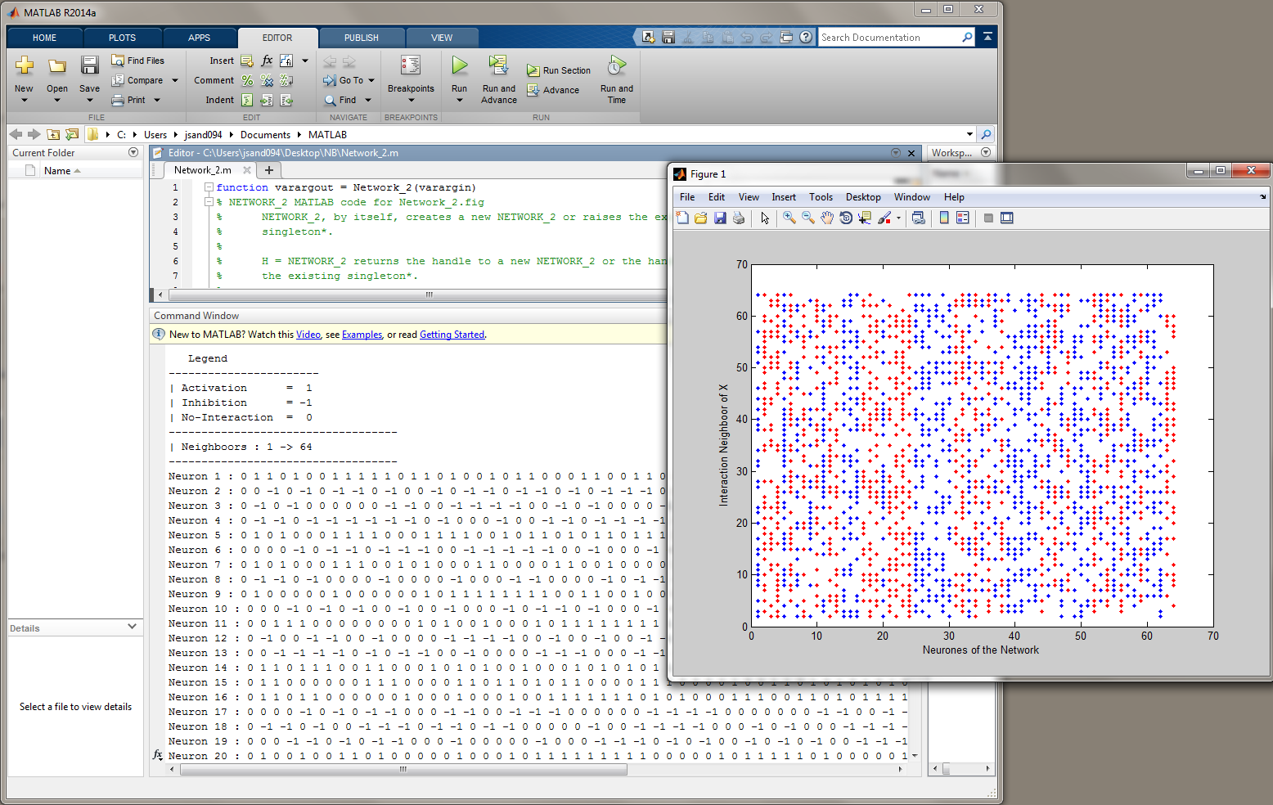
4-First Results

Slide 12
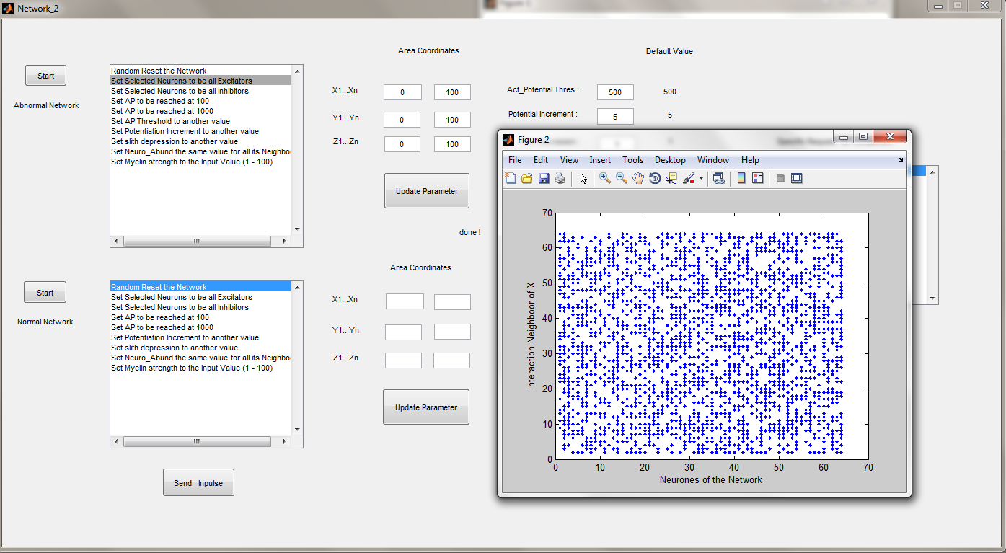
4-First Results
Let s set all Neurons to be Excitators.
Remember, exitators is blue

Slide 13
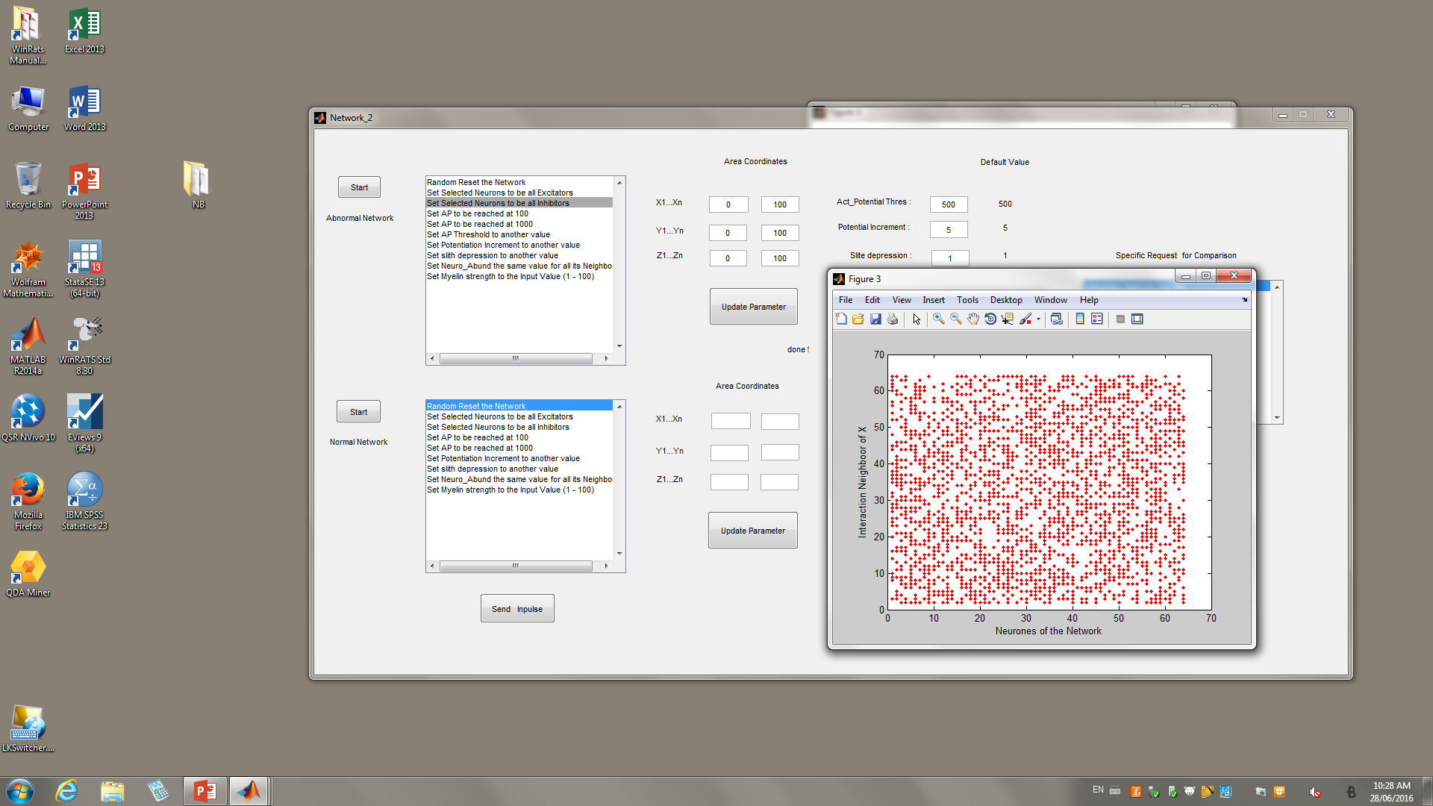
Let s set all neurons to be inhibitors.
Remember, inhibitors is red.

Slide 14
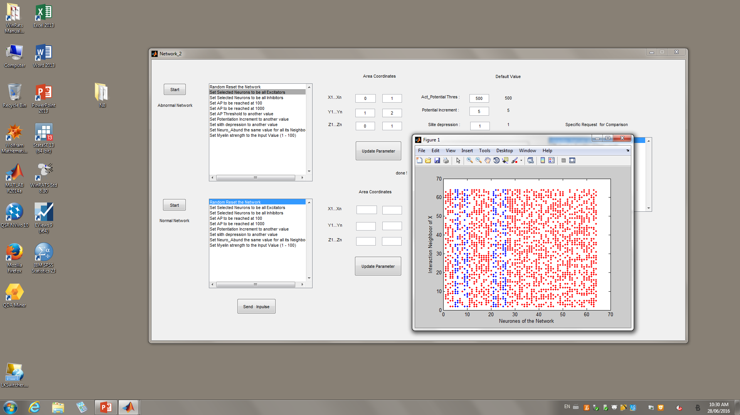
4-First Results
Let select only neurons which coordinates are inside selected Area, to be Excitators.

Slide 15
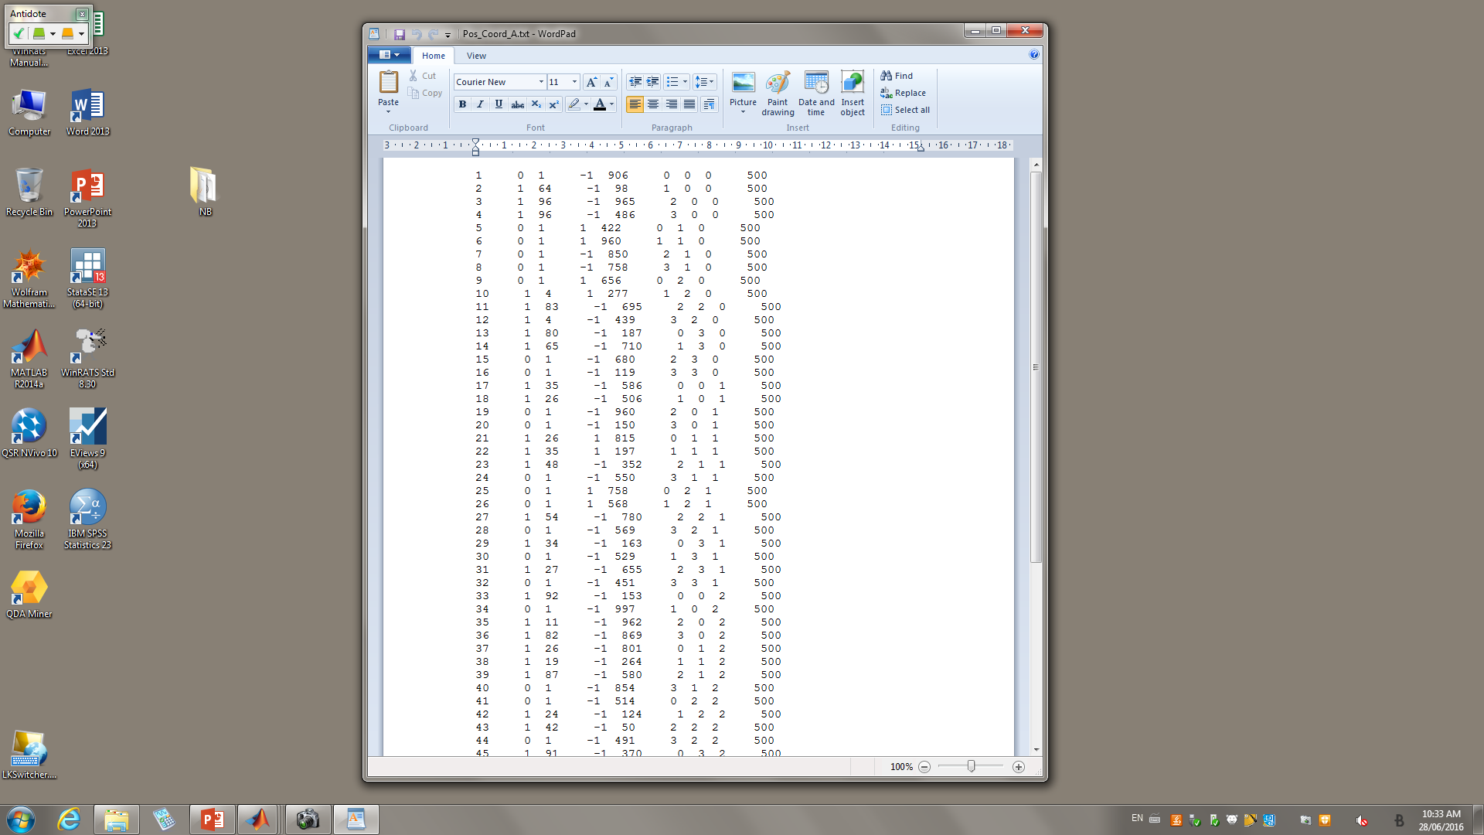
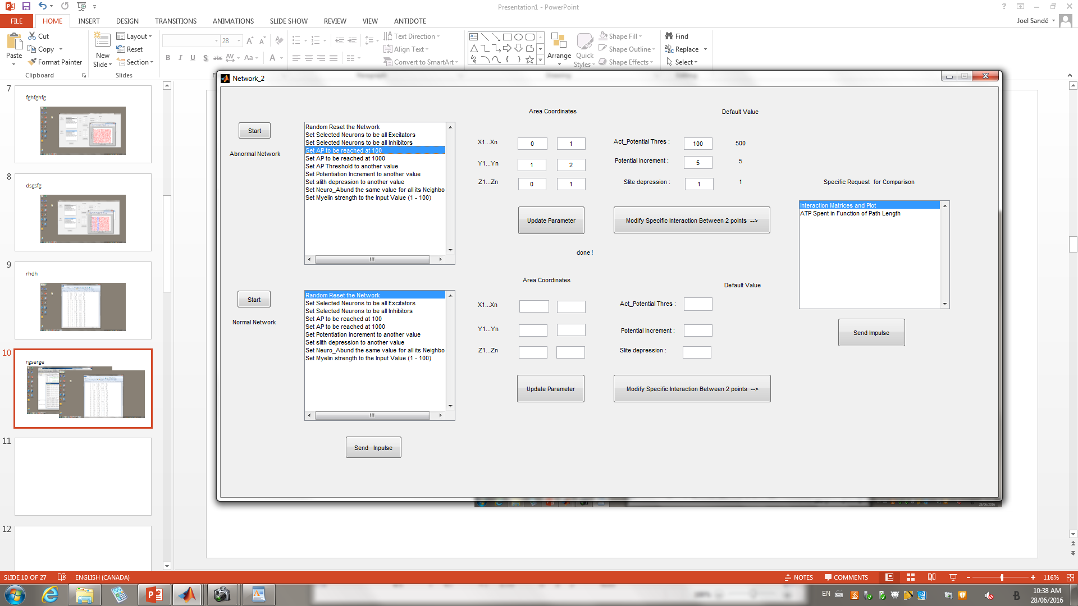
4-First Results
This is the Main_file that stores all initial Neurone information.
As you can see, we have 8 neurones Excitator (+1) from last set up.

Slide 16
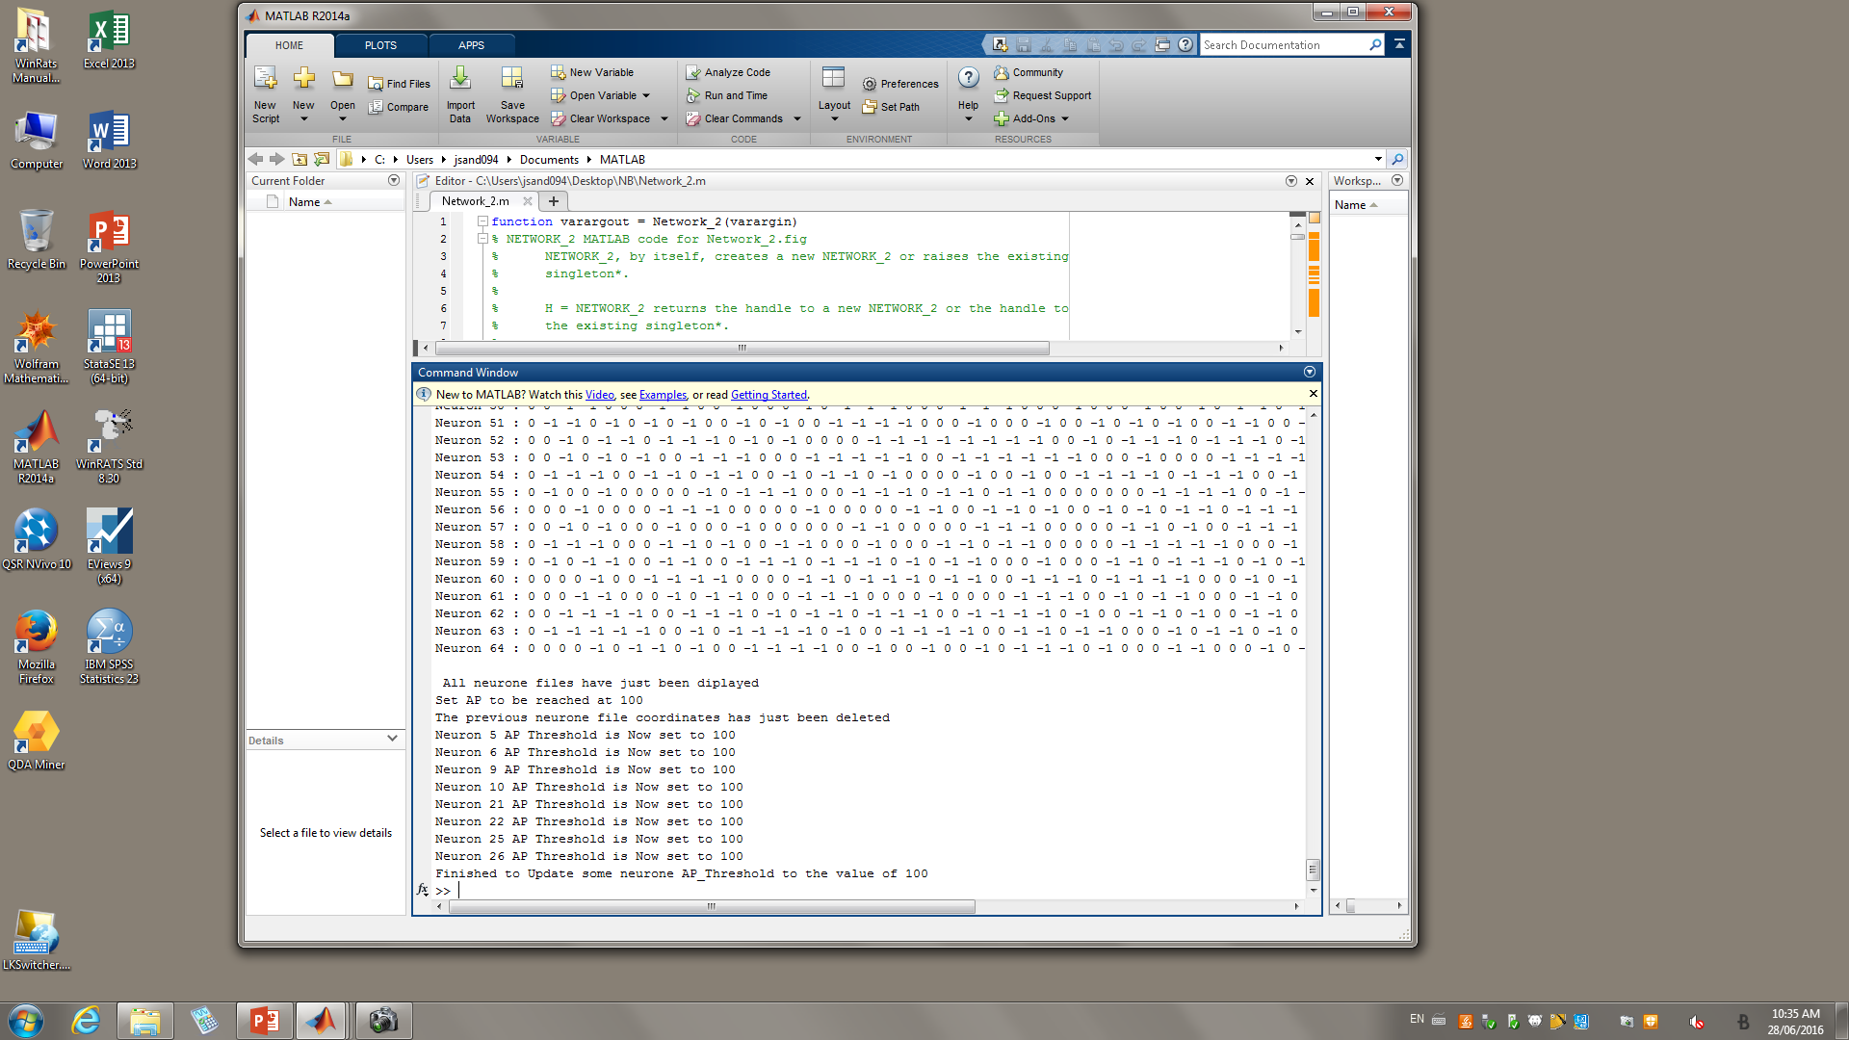
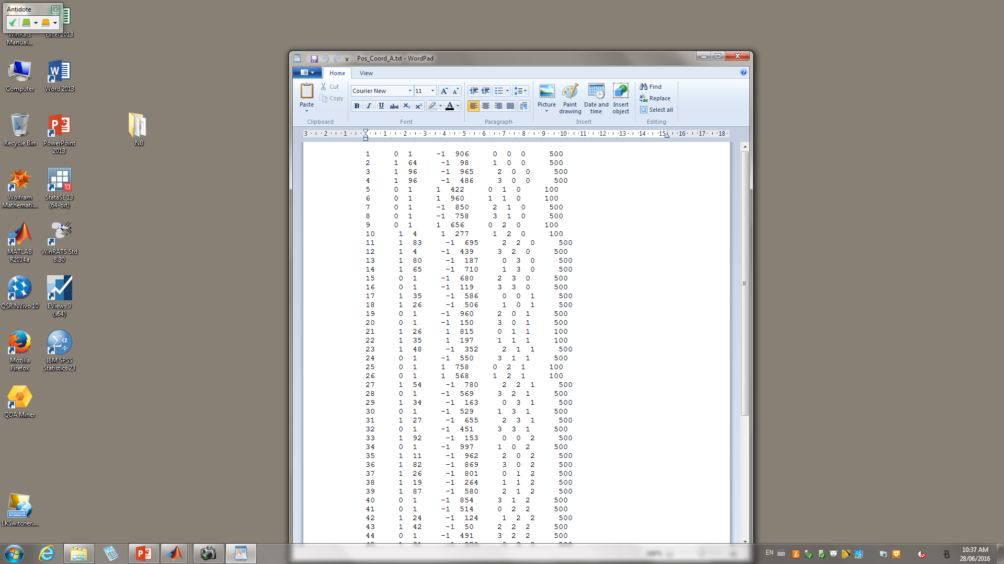
4-First Results
Set selected Neurons Action Potential to be reached at 100 neuro-transmitors.

Slide 17
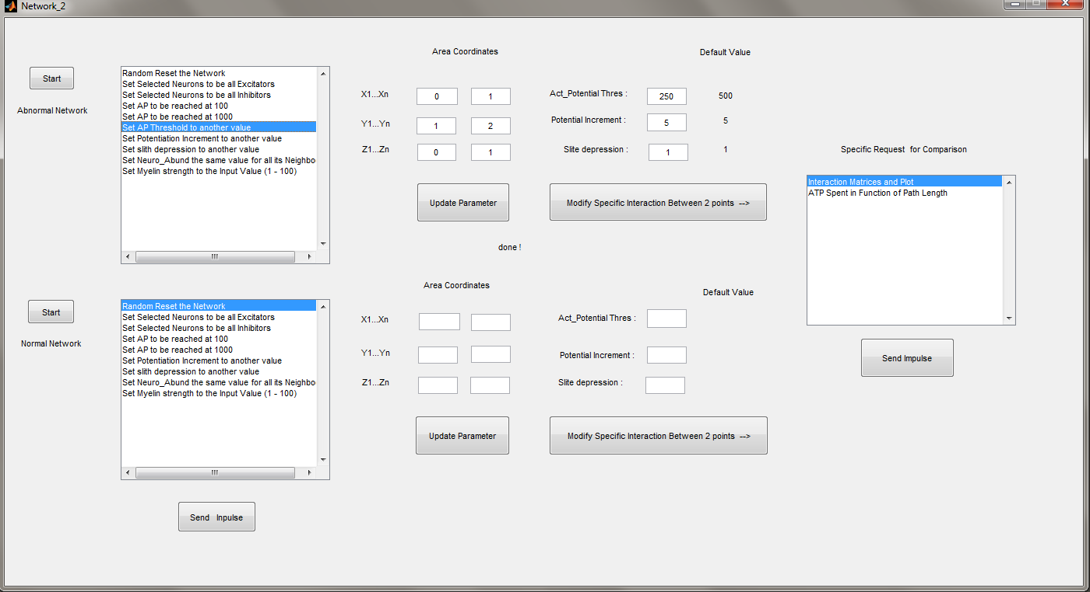
4-First Results
Set selected Neurons Action Potential to be reached at another number of neuro-transmitors.
Random value here is 250

Slide 18
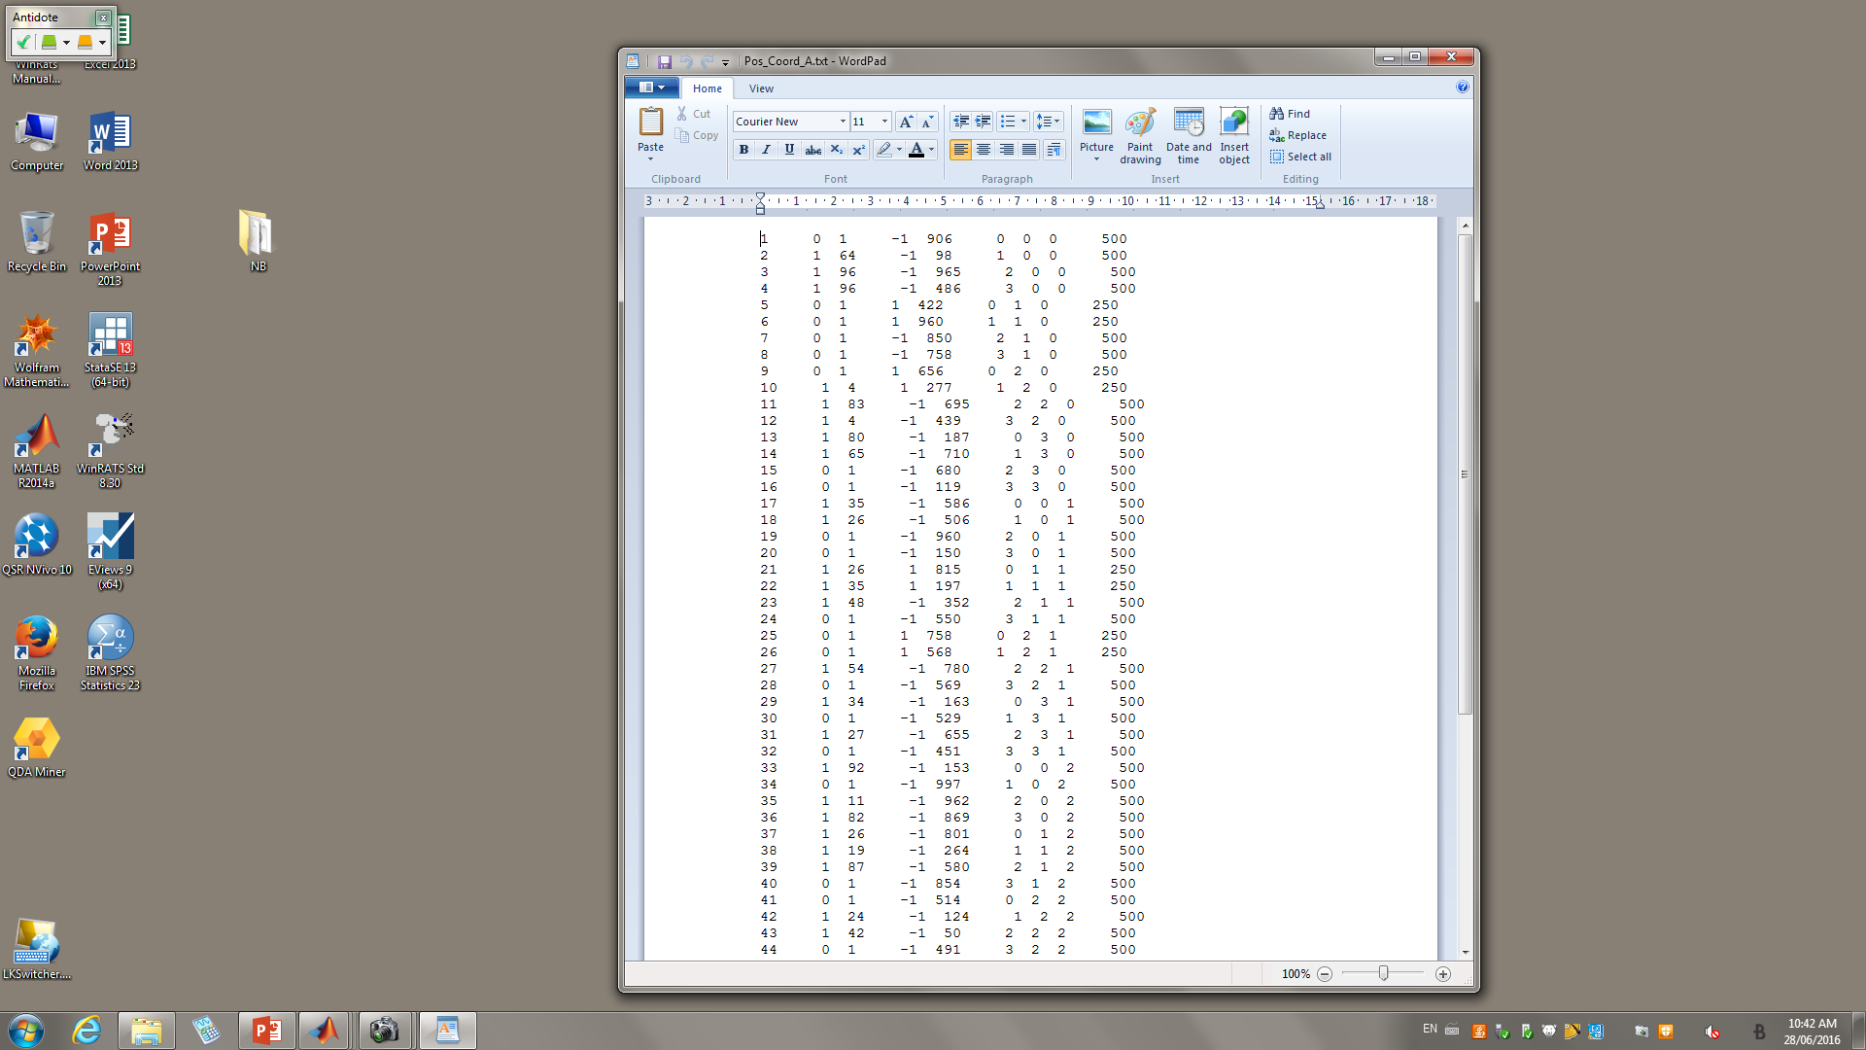
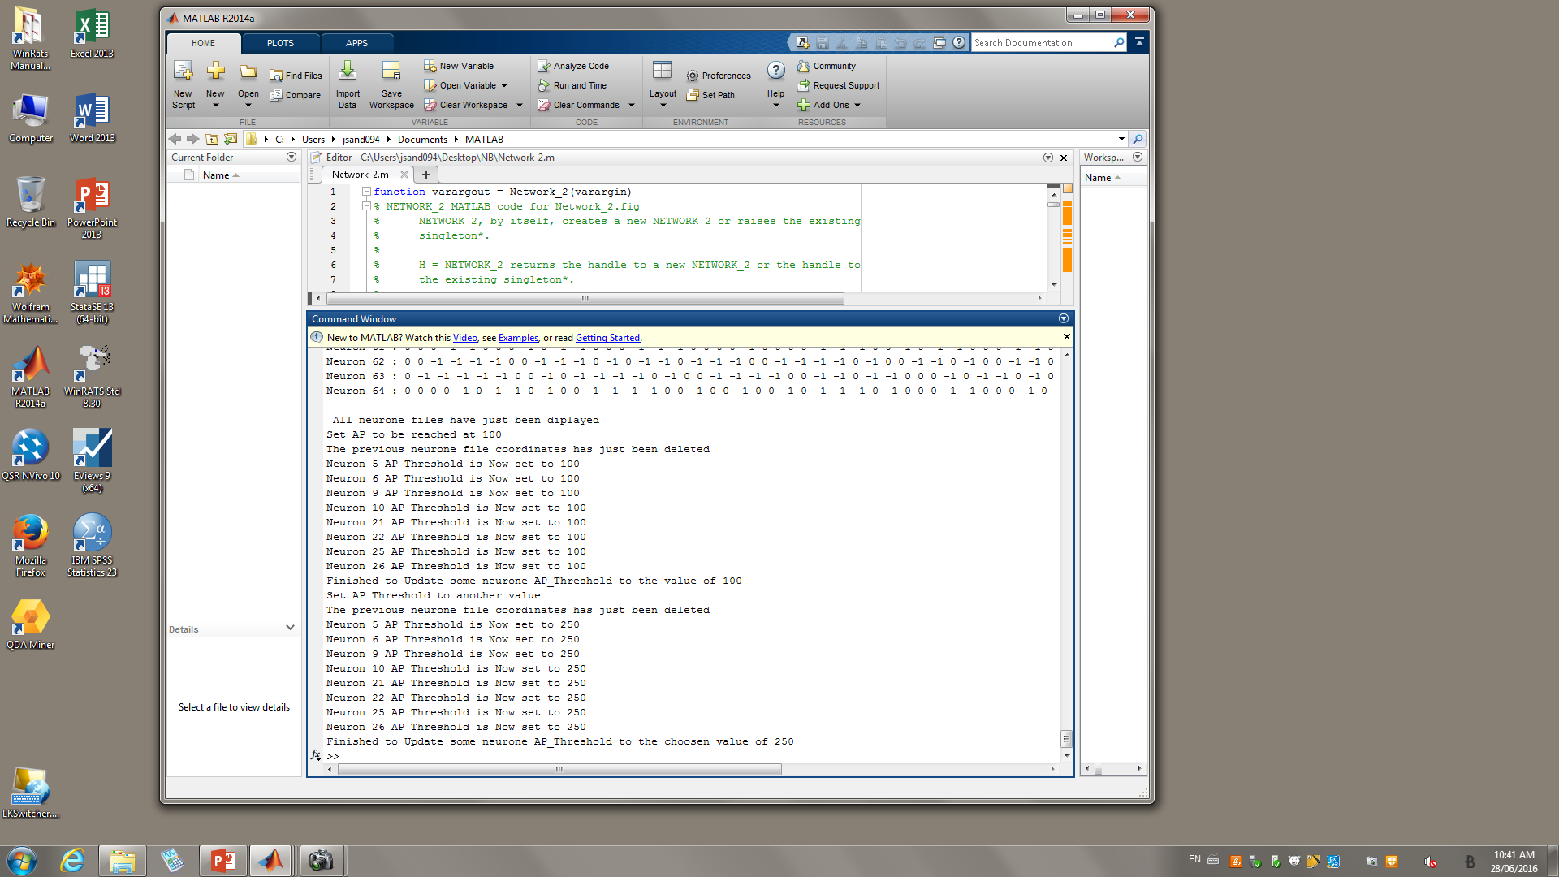
4-First Results
Action potential can be reach with 250 neuro-transmittors

Slide 19
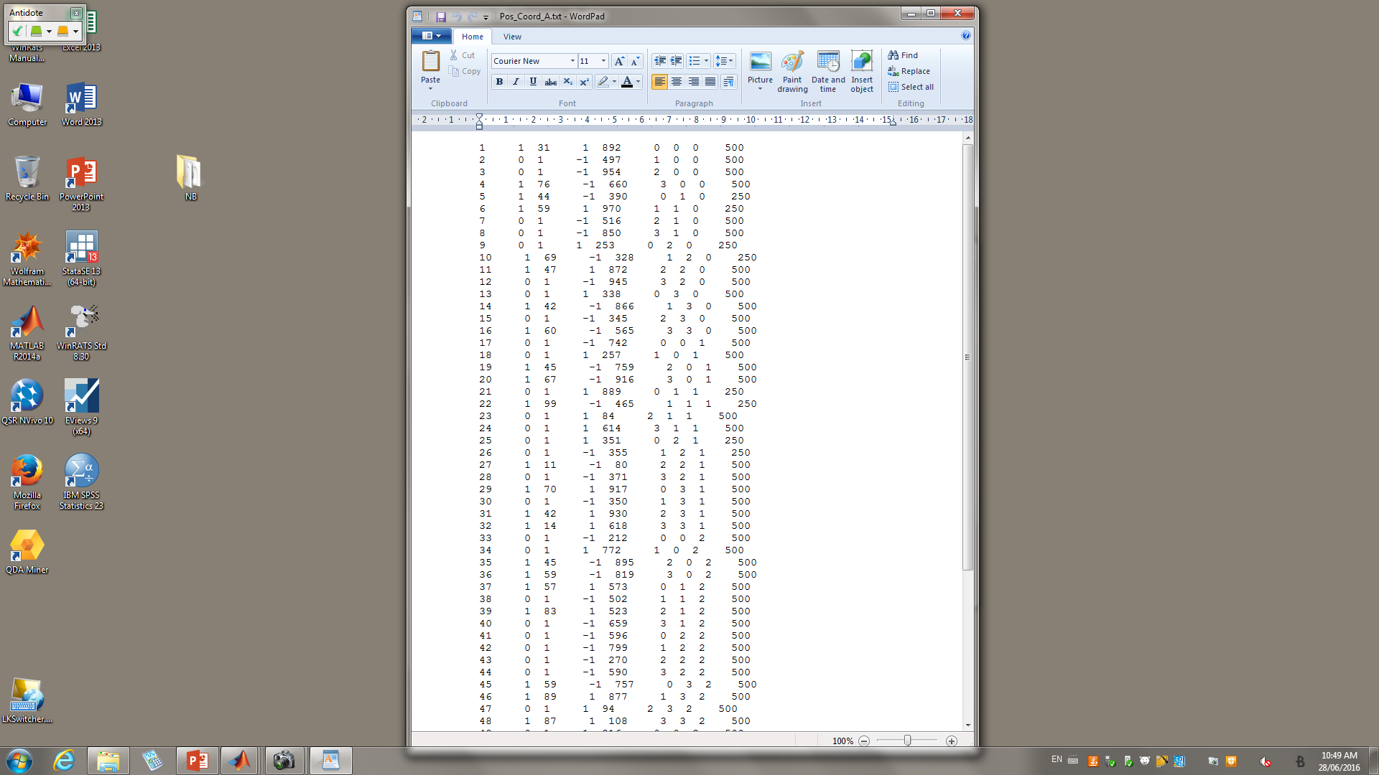
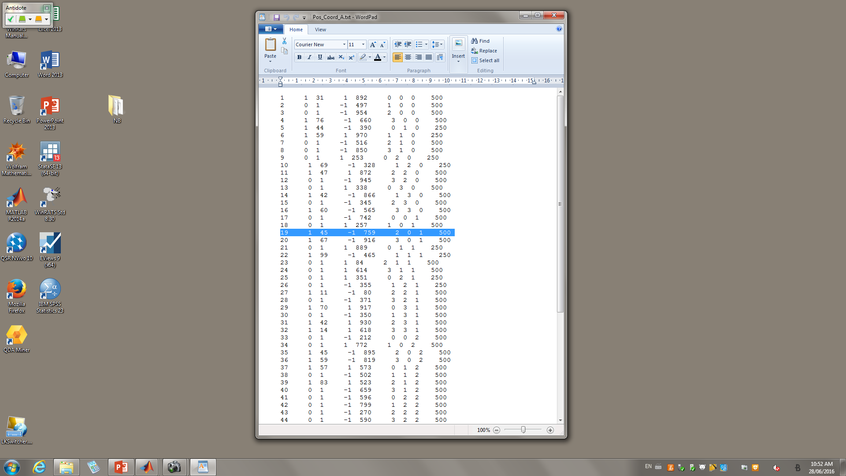
Let s randomly take Neuron 19
It is an inhibitor (-1)

Slide 20
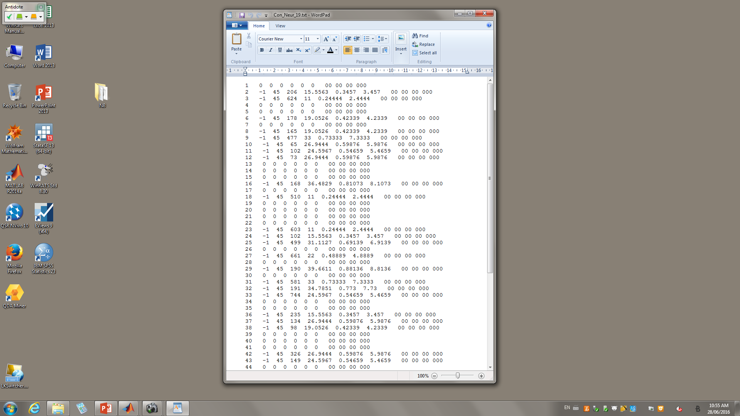
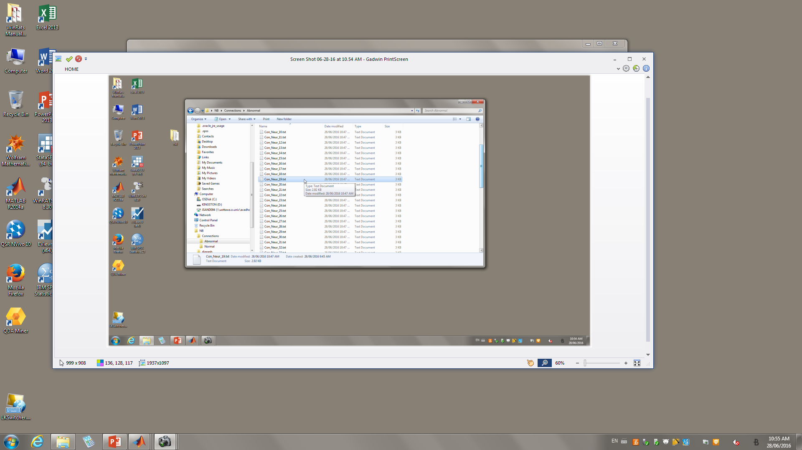
He has either 0 or 1 inhibition connection with its neighboors
Its current strength with Neuron 37 is 134

Slide 21
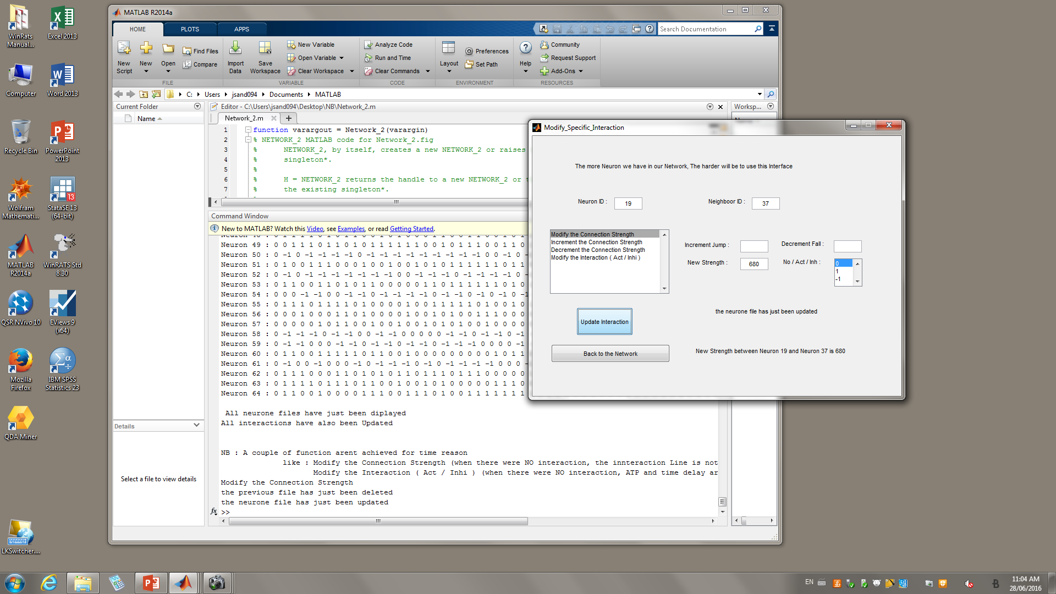
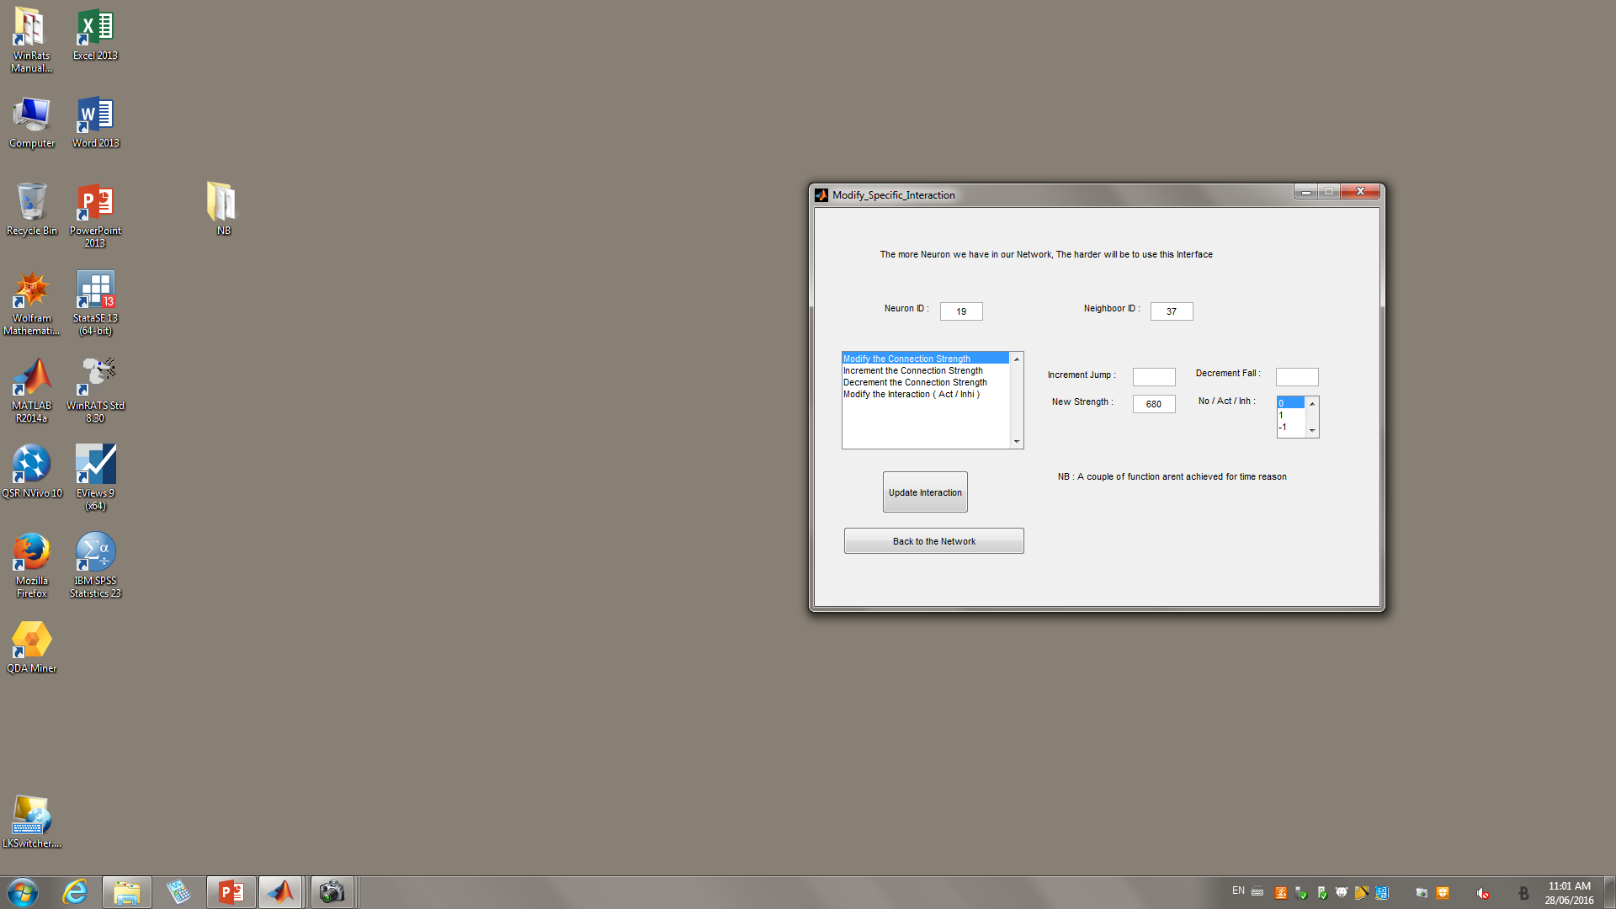
Modify strength of 19 & 37
The last request in the listbox is not achieved for time reasons.
We update that strength to 680

Slide 22
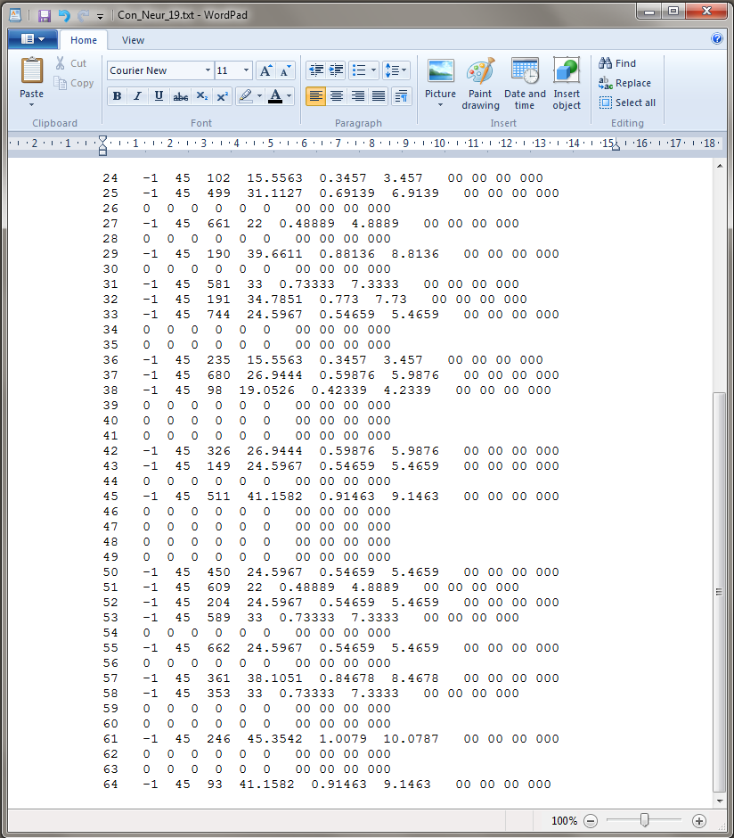
Back to the File

Slide 23
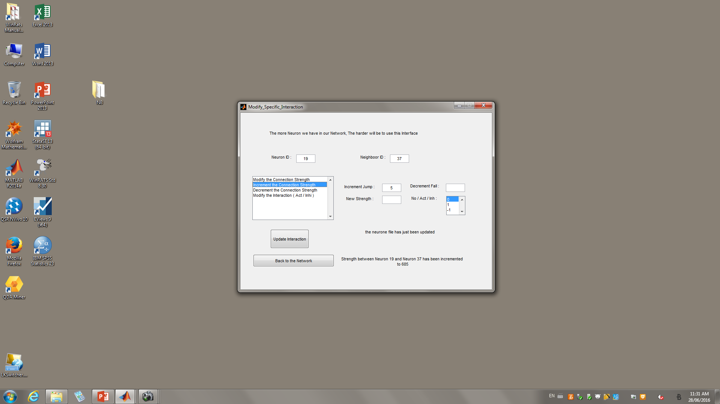
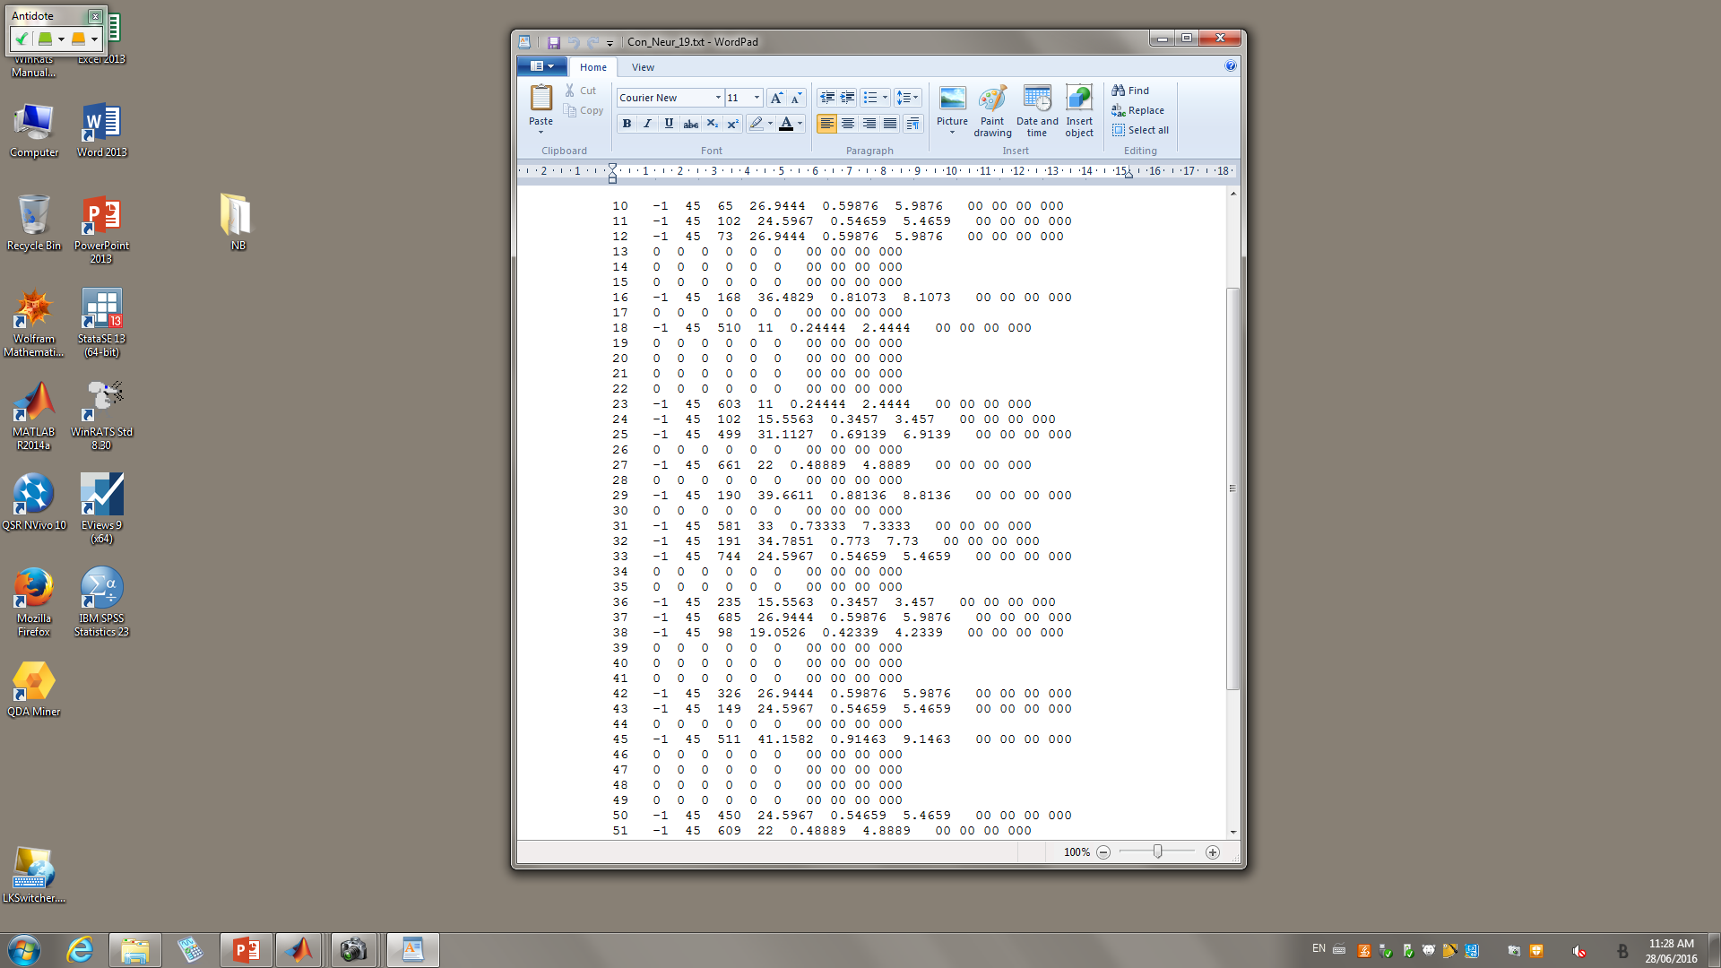
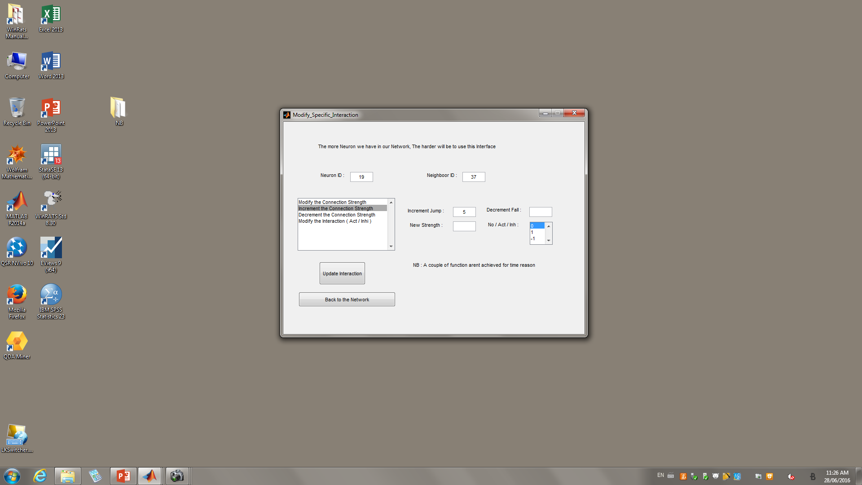

Slide 24
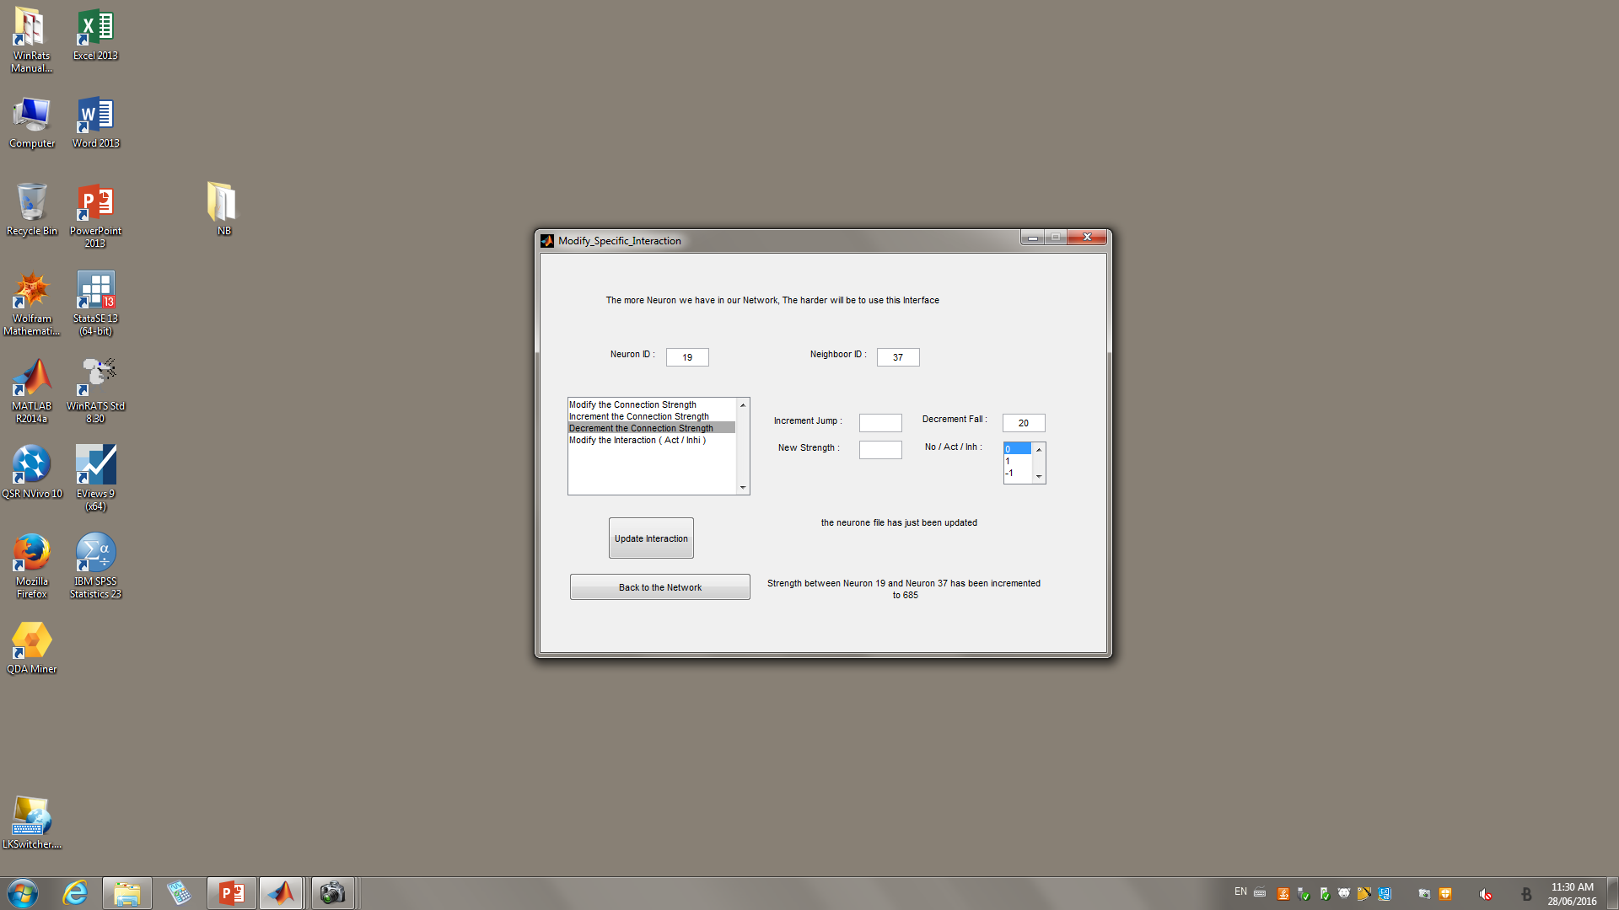
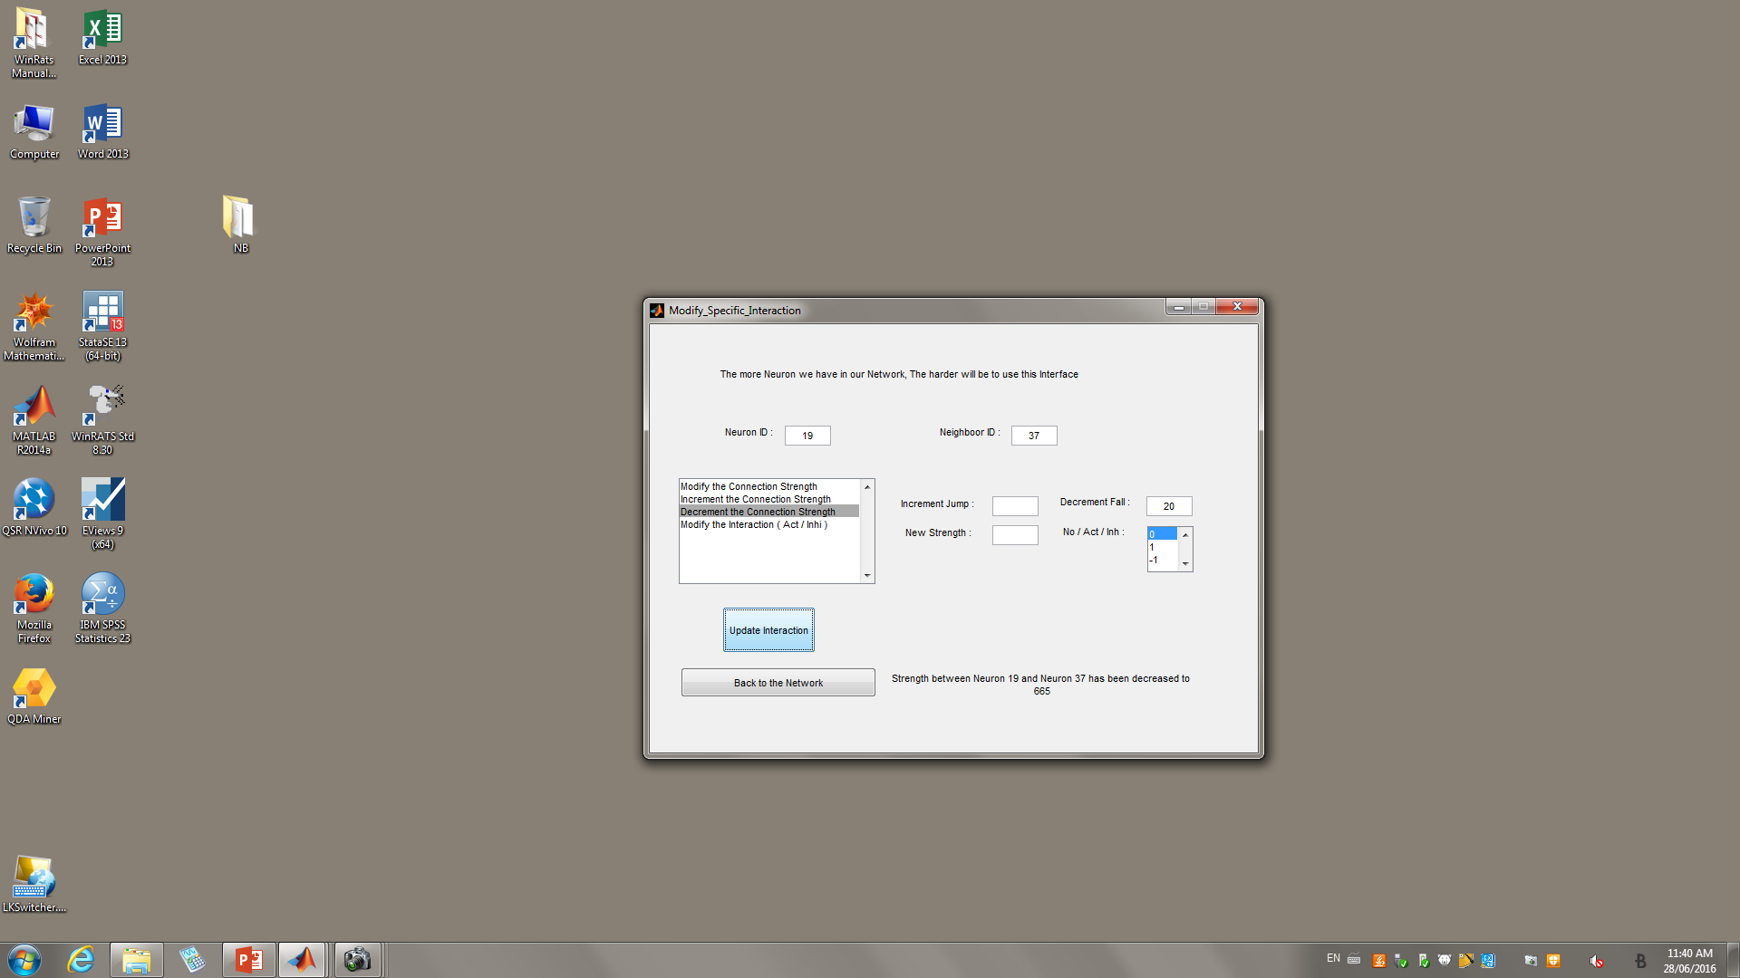

Slide 25
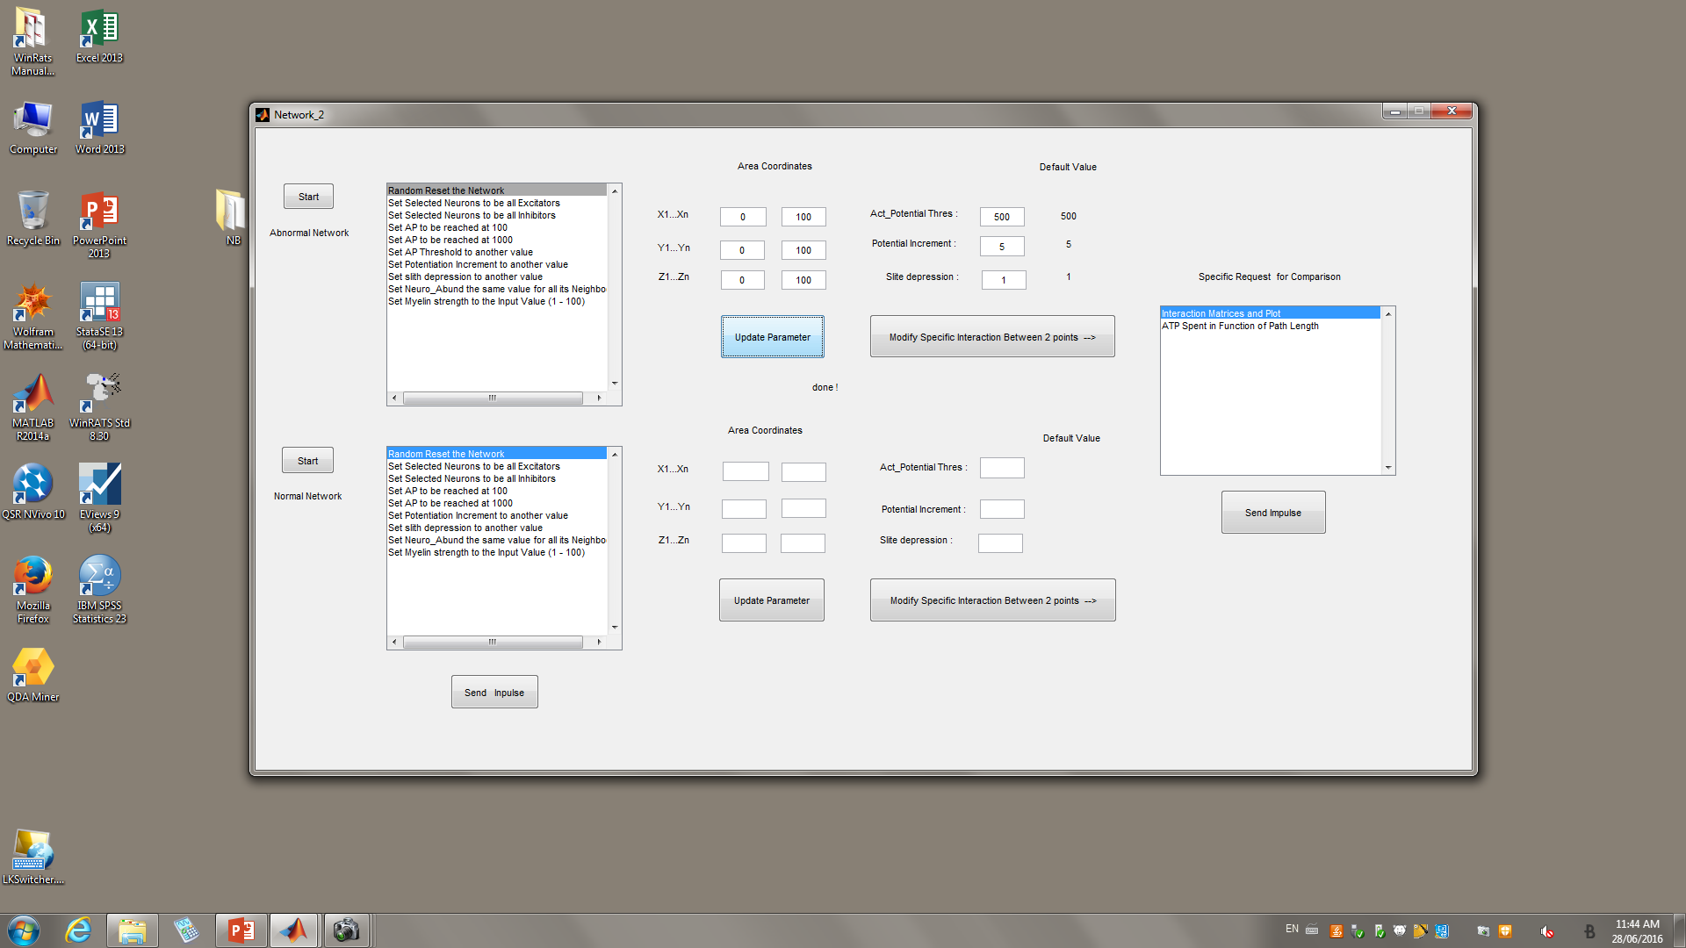
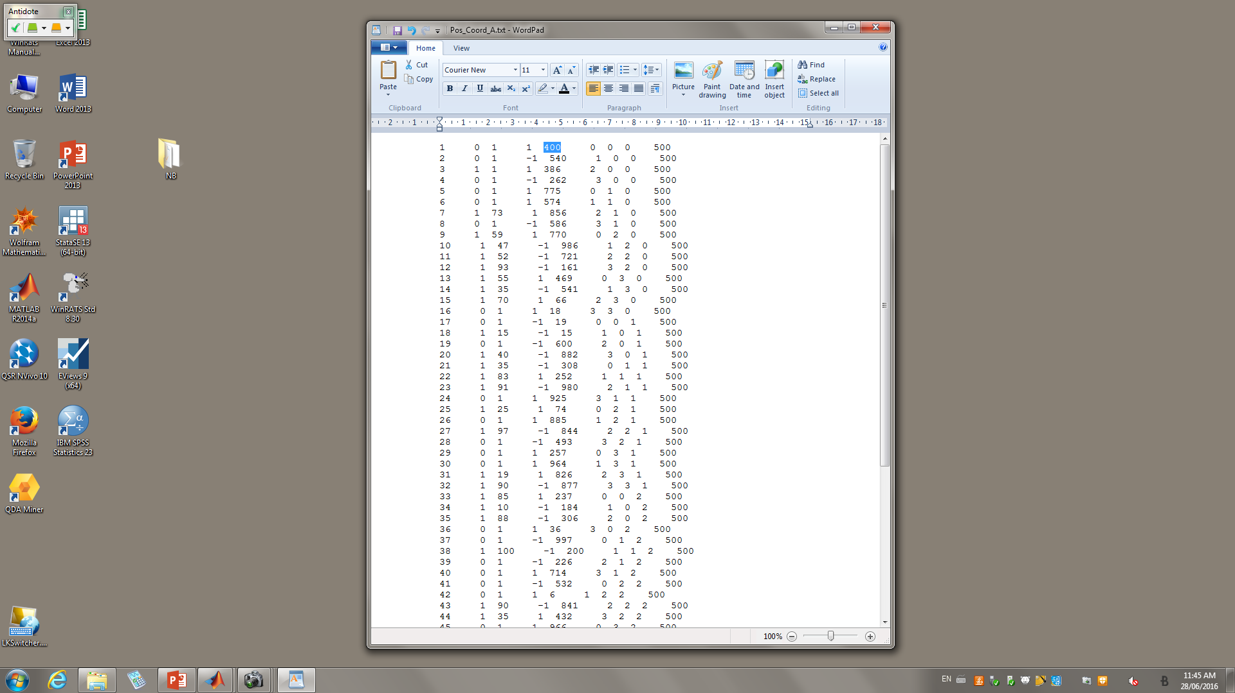
Let s go back to the Network
When one submit an impulse, the Neuron1 is the first neuron that it : Receptor Neuron. The last column is the action potential threshold. When neuron 1 will send its signal to its neighboors, for this simulation, I manually put its neurotransmitors (the power with which he excites its neighboors) to 100. In that case, he cannot excite none of its neighboors which threshold is 500 > 100.

Slide 26
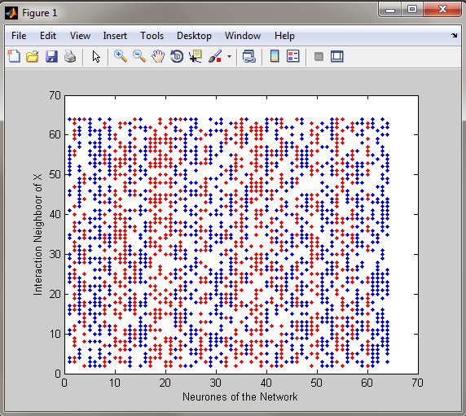
After updating the network, this is the interactions profile for this simulation

Slide 27
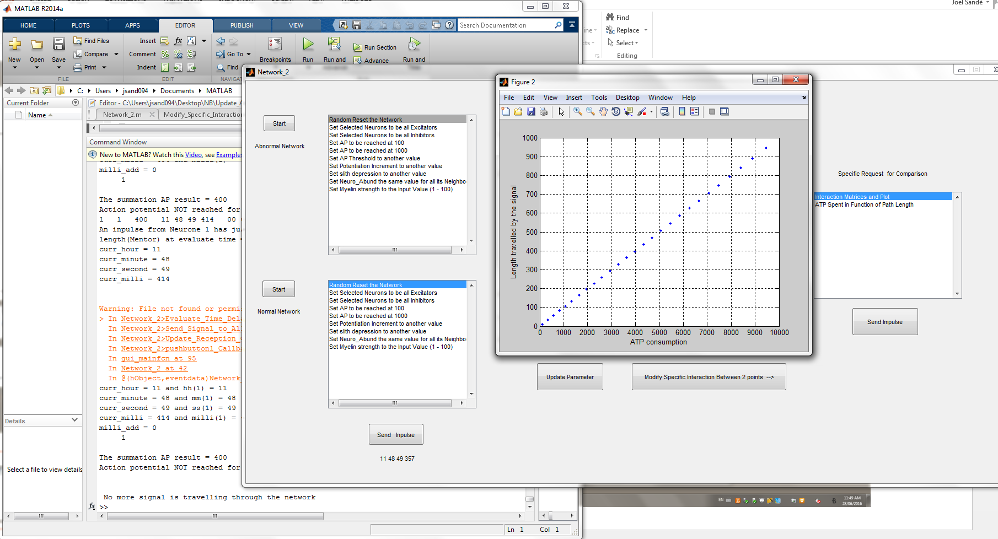
gfnsfgn
As I mentionned in implementation, I coded the network to follow the signal
When the myelin is not altered, and we consider one neuron at the time, we can see a direct relationship between ATP consumption and Length travelled by the signal.

Slide 28
5-A couple of comparisons
This part is to compare the Normal Network and the Abnormal network. Right now, white I am writing this, I am reviewing a function that unfortunately saturates Matlab while running the whole simulation, because of iterations error. Matlab stores too much data, and stop running after.. 5 - 10 min. I will be able to do more simulations once I fixe that problem.
Current work

Slide 29
6-Conclusion
The conclusion we can make from slide 27 is that : When the myelin is not altered, and we consider one neuron at the time, we can see a direct relationship between ATP consumption and Length travelled by the signal.
Not enough results on the network processing itself because of time constraints.
However, session 4 provides good results regarding the network implementation.

Slide 30
7-limitation
As I don t have huge computer to do a multithread,
1) I cannot run simultanely both Abnormal and normal Network. I have to run one network at the time.
2) As I don t have huge computer to do a multithread, I can only send one signal and wait for that signal to disappear completely before I send another one
Solution : To use Supercomputers to do the simulations

Slide 31
8-Futur work
I found a function named Digraph available in Matlab 2016. A powerful function that :
gives the shorter path in a given network, from a point A to a point B,
topology that allow to connect neighbour neuron in specific pattern,
… a lot of new stuff we can do, such as representing areas for the frontal lobe, visual lobe, ...
Run more simulations varying different parameters :
I can base the neuroplasticity on function available via matlab 2016 in addition to what I already did.
As the brain is lasy, I can easily choose in a simulation to keep only paths that spend the less energy possible and see how it impacts the network topology, using functionalities available on Matlab 2016.

Slide 32
8-Futur work
I have a solution to implement data memory, and even, artificial intelligence within the system (algorithms based on this work). We can perform reminding based on synaptic-connections. What is interesting with those algorithm, they can give you (in output) only what you input, starting at a completely stupid stage : at the beginning there is no output possible until you start putting repetitively the same inputs.

Slide 33
8-Futur work
I believe that to understand how disease like Alzheimer and Autism (memory disease) work, we have to get that kind of algorithm coded inside a network (and make difference between different compartments of the brain), and if that works well in the simulations, we can understand far beyond ATP and length issue, but also at the connection level.
→ this is not for today ☺

